Slide 1



CSCi 4907 – Midterm project presentation
Title
Names and Affiliations
Spring 2024
Photo: Kartik Bulusu

Slide 2

Introduction and motivation
Key points in intro:
Point 1
Point 2
point 3
What motivated you or your group:
Point 1
Point 2
point 3
Use drawings or references if necessary
What were your expectations and goals for your project:
Talk about where and how the project idea started
How you or your group ideated
What were the broad goals set
Tech-product
Future start-up
A part of your senior design
Or simply exploratory
Task breakdown per group member:
Member 1’s tasks
Member 2’s tasks
Member 3’s tasks

Slide 3

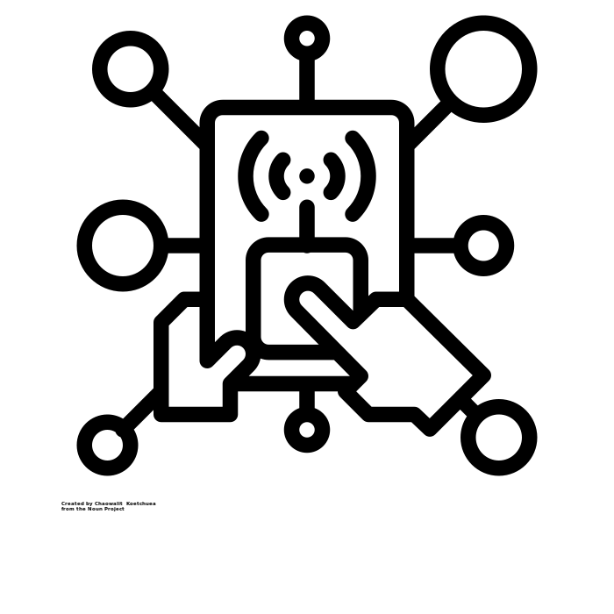

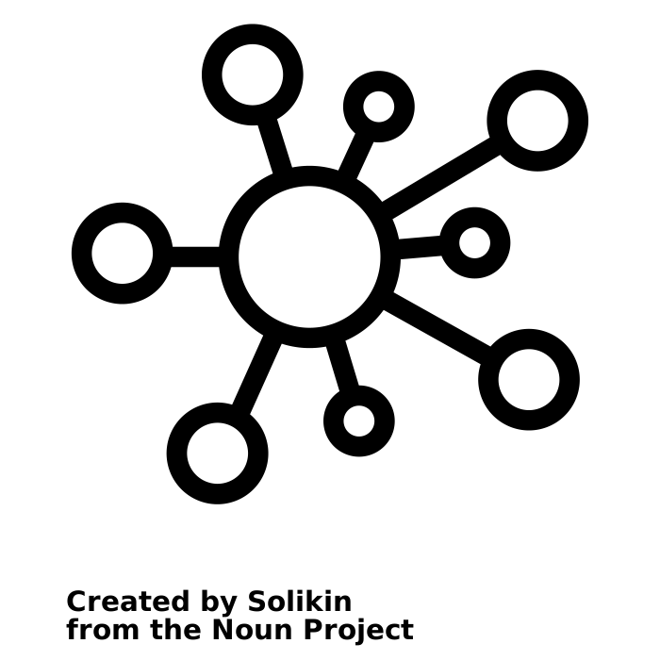
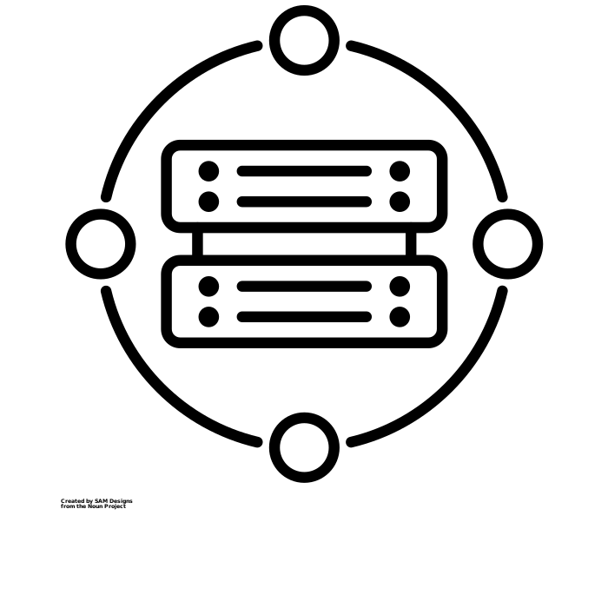
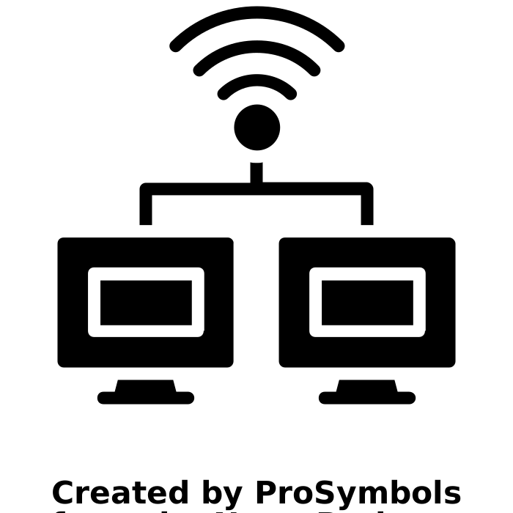
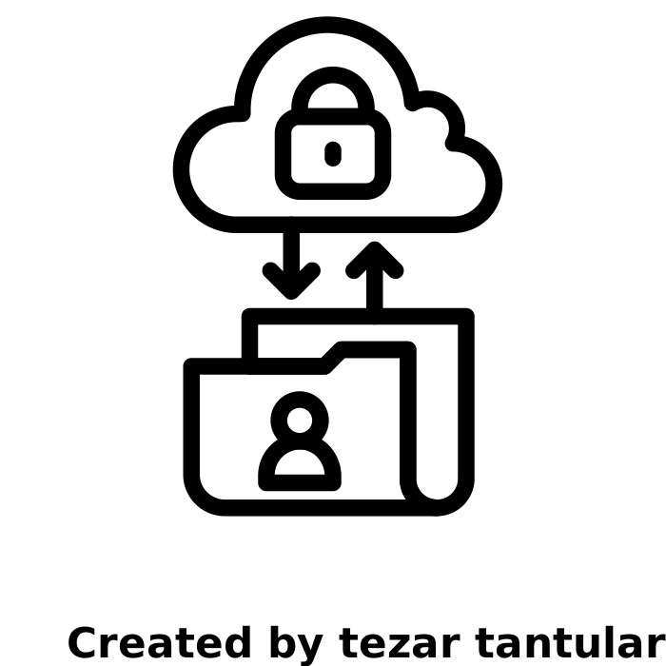
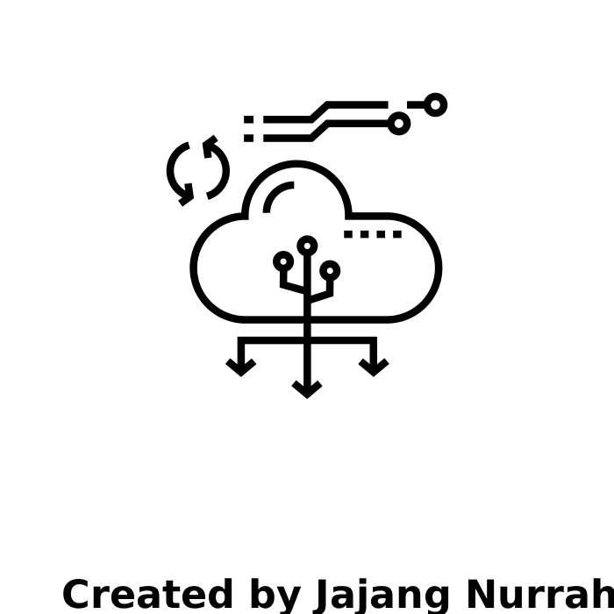
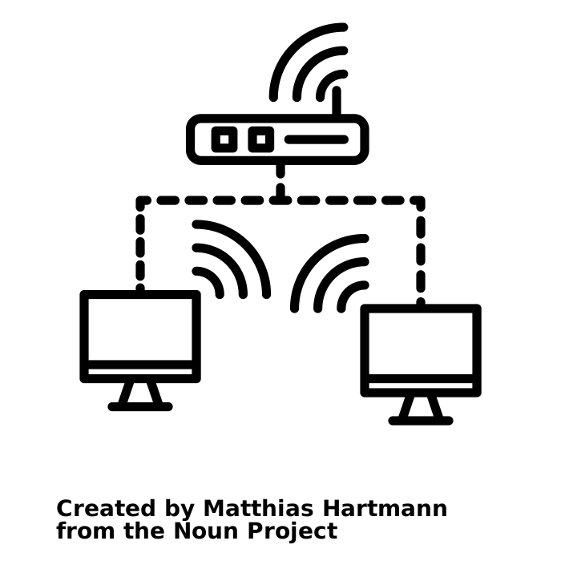


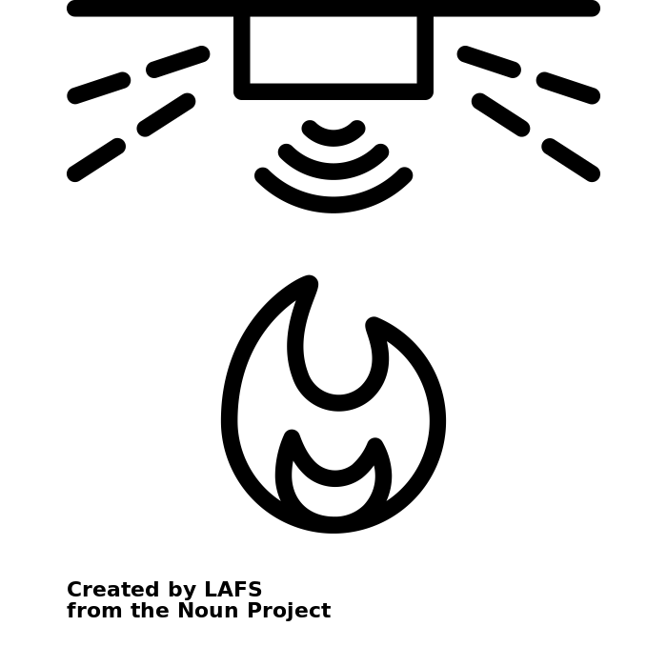
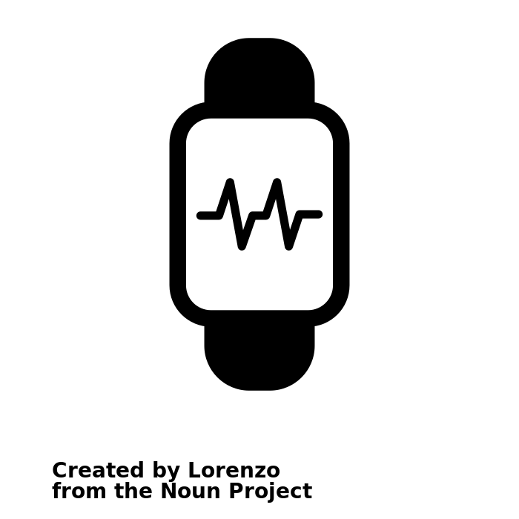
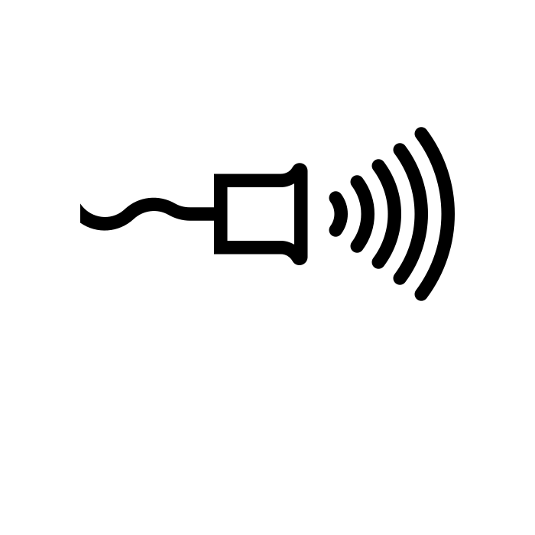
What model did you chose and why ?
How does your “thing” and related firmware elements fall into place in your model ?
Business
Application
Middleware
Network
Perception
Interface-layer
Service-layer
Network-layer
Sensing-layer
Sources:
sensor by Carolina Cani:, sensor by Pham Duy Phuong Hung, sensor by Tippawan Sookruay, sensor by Lorenzo: https://thenounproject.com/browse/icons/term/sensor
wifi network by Matthias Hartmann:: https://thenounproject.com/browse/icons/term/wifi-network/
application by Chaowalit Koetchuea: https://thenounproject.com/browse/icons/term/application/
IoT Architecture layers: https://www.startertutorials.com/blog/iot-architecture-layers.html
Notes:
Perception Layer: Is the physical layer which contains sensors to gather data.
Network Layer: Deals with transferring the data from perception layer to middleware layer.
Middleware Layer: Stores, analyzes, and processes data coming from the network layer.
Application Layer: Responsible for delivering application services to the users via user interfaces.
Business Layer: Responsible for managing the whole IoT system, including applications, profit models, etc.
Sensing Layer: Is the physical layer which contains sensors to gather data.
Network Layer: Transfers the data from sensing layer to service layer.
Service Layer: Creates and manages services required by users and applications.
Interface Layer: Provides interfaces to interact with the services provided by the service layer.

Slide 4
Materials and methods
Materials and hardware used:
Sensor1
Sensor2
Raspberry Pi make model and OS
Microcontroller used (Arduino, ESP32 etc) and why
Protocols used (Wifi, Bluetooth, Zigbee etc.) and why
Schematic drawing and images of the final set up with adequate labelling:

Slide 5
Firmware and frontend development
Description ofd App or API developed and strategy incorporated:
Python + Flask library
Python + plotly library
Chart.js
Html-frontend
JavaScript
Flow chart or step-wise breakdown on how it all came together:

Slide 6
Edge compute strategy – Optional for midterm project
Describe the data source for your IoT device
Why is it important for edge compute necessary in this device ?
How did it or does it impact your understanding of your IoT data
Flow chart or step-wise breakdown on methods used to compute or process data acquired by your IoT system:
Matrix theory
Filtering
Signal processing using FFT
Python programming on the edge

Slide 7
Conclusions and demonstration
Complete the story and summarize what your learned ?
Did you and your group meet all expectations and goals set ?
Discuss briefly about how it all worked out
Tell us if you can scale-up (or make multiple clones of) this IoT device
Will scaling up help or impact the great goal of the application ?
Is there a humanitarian or commercial interest in this IoT device
Who are the beneficiaries of your IoT device ?
Any compelling information or “Aha” moment
Demonstrate your IoT device

